Slide 1
LendingClub Minimizing Risk During Loan Process
By
Janis Navarro

Slide 2
The Problem:
Credit risk is the greatest risk faced by most financial lending institutions.
Poor credit risk management and failure to identify deteriorating credit quality in a timely manner, may lead to higher future financial institution losses and undermine confidence in the baking sector.

Slide 3
The Solution:
Identify higher risk variables for written off accounts and identify these potential write off accounts during the loan application process.

Slide 4

The Data

Slide 5

LendingClub is a bank that is the only full-spectrum financial technology marketplace bank and first public US neobank.
We will focus on their marketplace bank which is the world’s largest peer-to-peer lending platform.
Every time LendingClub receives a loan application, they must review and make decisions for loan approval based on the applicant’s financial profile.

Slide 6
Data Wrangling
Used raw dataset from 2007 to 2018 Q4 as available
Only considered accepted loan applicant data
Look for missing, NaN and fill values
Drop unnecessary features
Drop repeated features
Convert categorical features to dummy variables
Original dataset had 392.58 MiB of data and included a Words of the Wise Document with Data Description

Slide 7
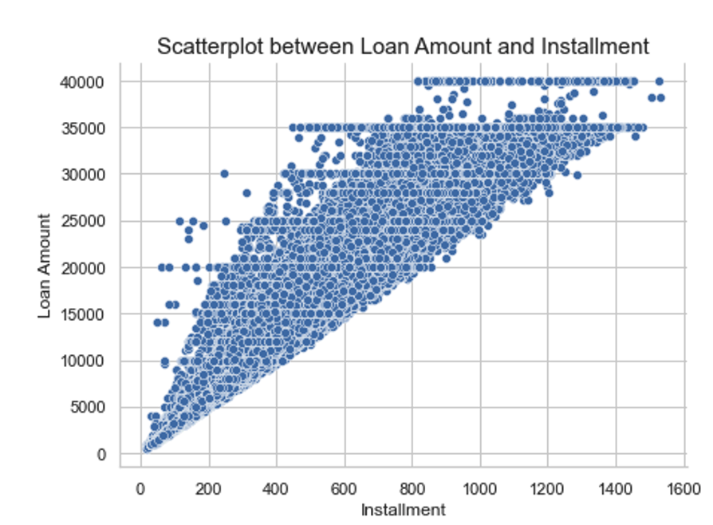
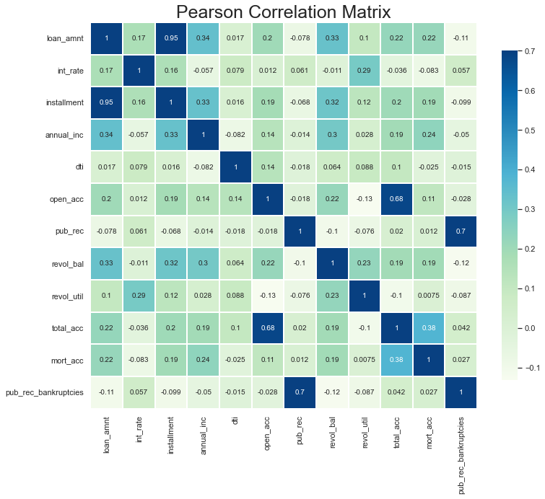
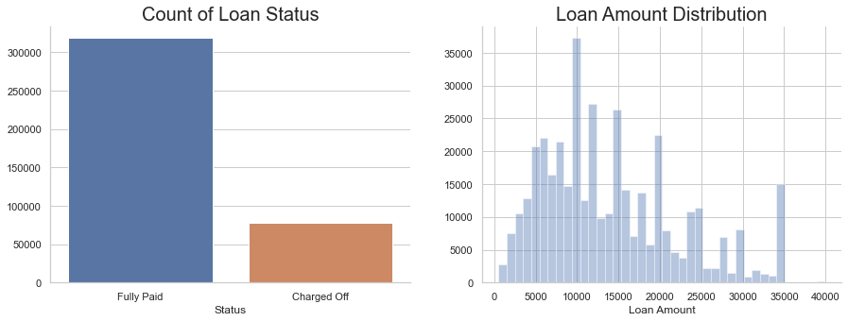
Exploratory Data Analysis

Slide 8
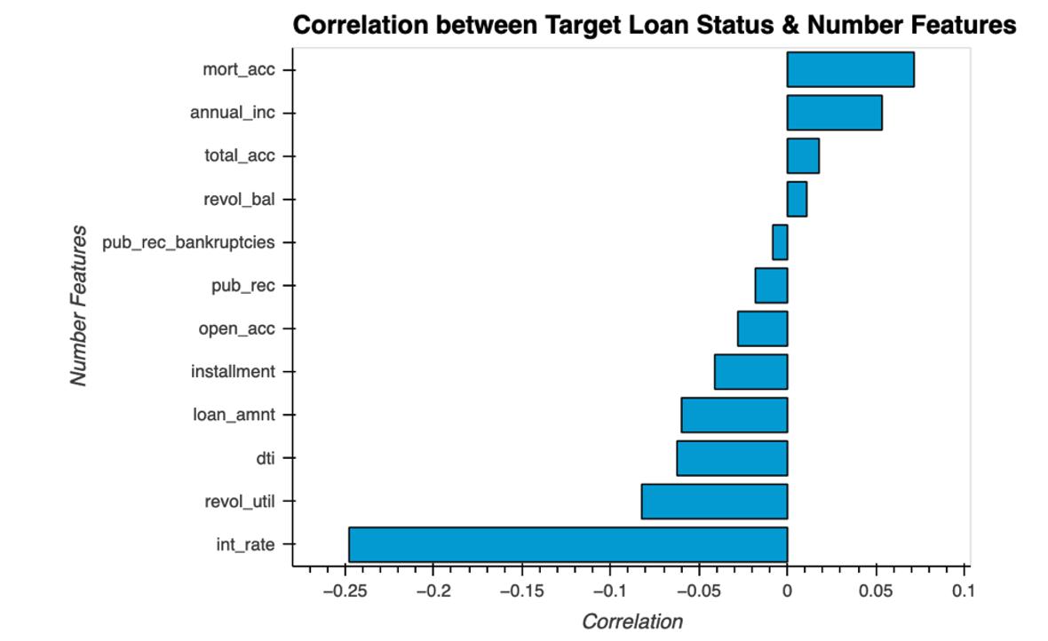
Two Category of Features
Category 1
Features Correlated to Loan Characteristics
Loan Amount, Interest Rate, Revolving Utilization Rate, Debt to Income Ratio, Installment, Open Accounts, Public Records
Category 2
Features Correlated to the Applicant
Number of Mortgage Accounts, Income, Occupation, Employment Title

Slide 9
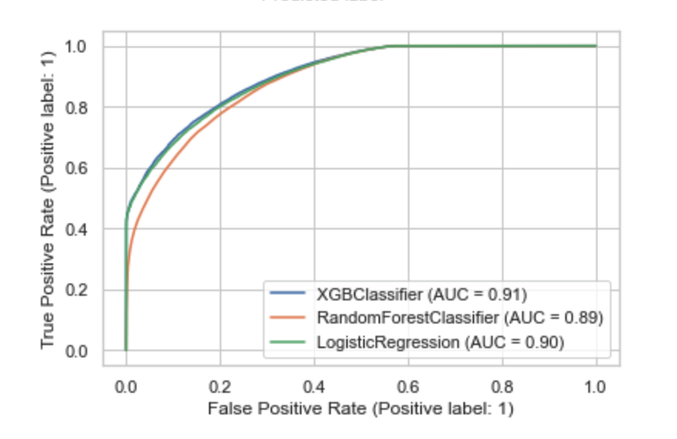
Model Selection
Logistic Regression
Random Forest Classifer
XGBoost Classifier

Slide 10
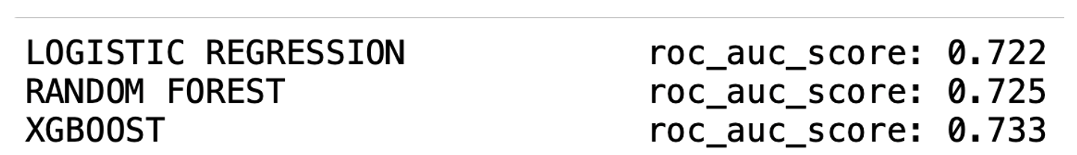
Comparing Model Performance
When it came to the models, the performance was very similar for all three.
I completed a Performance Model Comparison of all three and yielded:

Slide 11
Takeaways
XGBoost had the best performance
Logistic Regression had the worst
False positives can cost LendingClub losses in approving loans to higher risk individual applicants
The features with the highest correlation to fully paid should be the target for LendingClub to use as their parameters within their lending policy

Slide 12
Future Research
While the models can be useful, it is difficult to gauge how useful they can be left at this point within the process
Has potential to explore using deep machine learning for prediction capabilities

Slide 13

LendingClub for use of their data Nathan George and LendingClub for making data publicly available Ricardo Alanis-Tamez for your patience, guidance and mentoring.

